Slide 1


Slide 2


Build .NET Applications with Visual Studio Code
Luis Quintanilla
Maria Naggaga

Slide 3
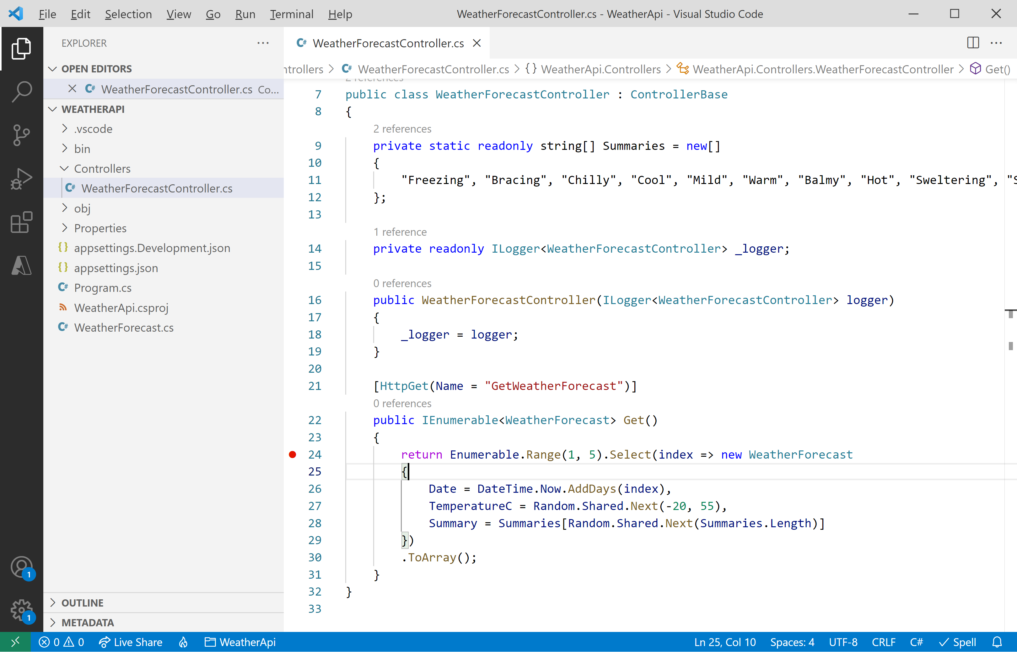
Visual Studio Code

Slide 4


.NET
Your platform for building anything
Desktop
Desktop
Web
Web
Cloud
Cloud
Mobile
Mobile
Gaming
Gaming
IoT
IoT
AI
Notes:
.NET is a modern, open source development platform for building many types of applications for many operating system and devices. With .NET, you can use multiple languages, editors, and libraries to build for web, mobile, desktop, gaming, IoT and whole lot more. .NET makes you more productive building feature-rich applications of any type, for any device, with great performance.
Today I’m going to show you how you can build apps for the future, with .NET.

Slide 5
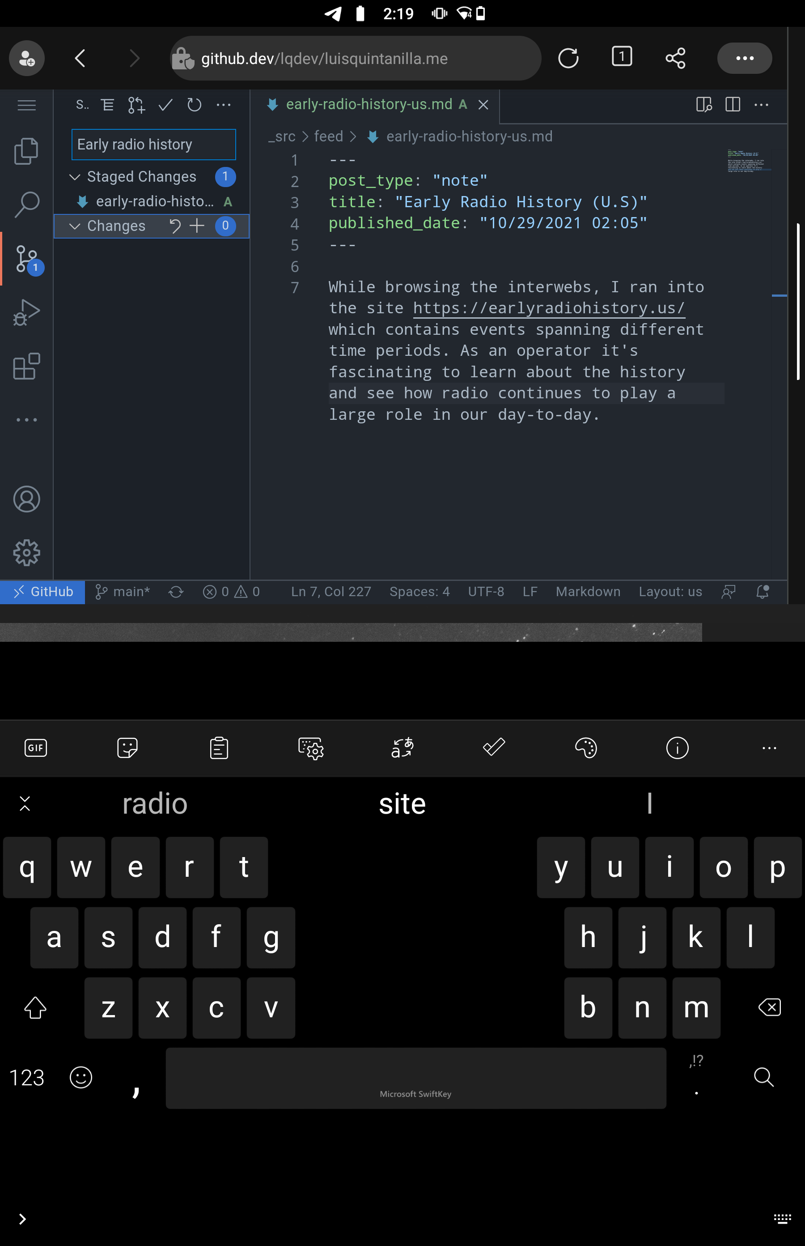
How to get started?
Locally
Cloud
Notes:
Local
Desktop app
Cloud
GitHub.dev
VsCode.dev

Slide 6
Demo
VS Code cloud development environments

Slide 7
Check out these sessions to learn more
Zero to Hero with GitHub CodeSpaces
.NET Everywhere – Windows, Linux, and Beyond

Slide 8
Building applications
Development workflows
.NET CLI
Interactive Programming
Notes:
Extensions
Ionide
OmniSharp

Slide 9
Interactive Programming
F# Interactive (fsi)
Notebooks

Slide 10
Demo
Interactive Programming

Slide 11
Check out these sessions to learn more
What’s new in .NET Interactive Notebooks
ML.NET: Machine learning from data to production in less than 30 minutes
Machine Learning for .NET developers

Slide 12
Debugging & Deploying Apps
Development containers
Azure Tools for Visual Studio Code

Slide 13
Check out these sessions to learn more
Testing tools for .NET and cross-platform apps
Minimal APIs in .NET 6
Real-world Minimal APIs

Slide 14
Demo
Debugging & deploying applications

Slide 15

Thanks for joining!

Slide 16
Two columns of content

Slide 17
Demo
Presenter

Slide 18
Code Sample
Code sample

Slide 19
Announcemnet
Value prop 1
Value prop 2
Value prop 3

Slide 20









Slide 21








Slide 22








Slide 23









Slide 24





Slide 25


Slide 26


Slide 27


Slide 28


Slide 29


